Slide 1
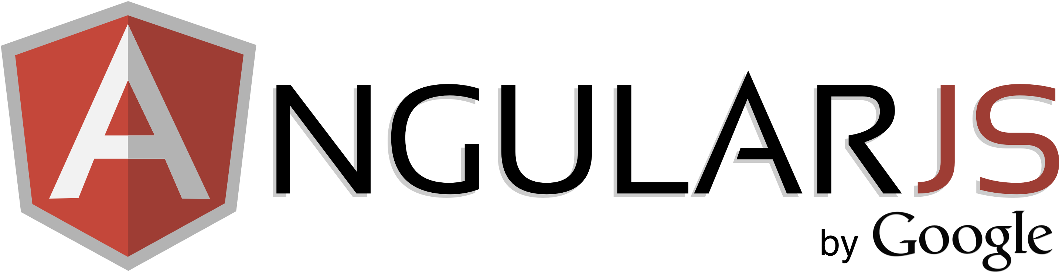
Open-source JavaScript framework
Developed in 2009 by Miško Hevery and Adam Abrons
Maintained by Google

Slide 2
Prerequisite
HTML5
CSS
Java Script (OOPs Concept)
MVC Architecture

Slide 3
Advantage / Why use it?
MVC pattern
Two way data binding
Single Page Application
Support restful API, form validation, unit testable, dependency injection etc. as compare to jQuery.
Notes:
Difference Between Window and Web Application
Introduction of Silver Light
MVC
MVC via Angular
JQuery vs AnuglarJs

Slide 4
Example-1
Hello AngularJS

Slide 5
What is Angular module?
Container for
Controllers
Services
Directives
Factories
Filters

Slide 6
Two-way data binding
View is updated automatically when the Model is changed
Model is updated automatically when a value in the View has changed

Slide 7
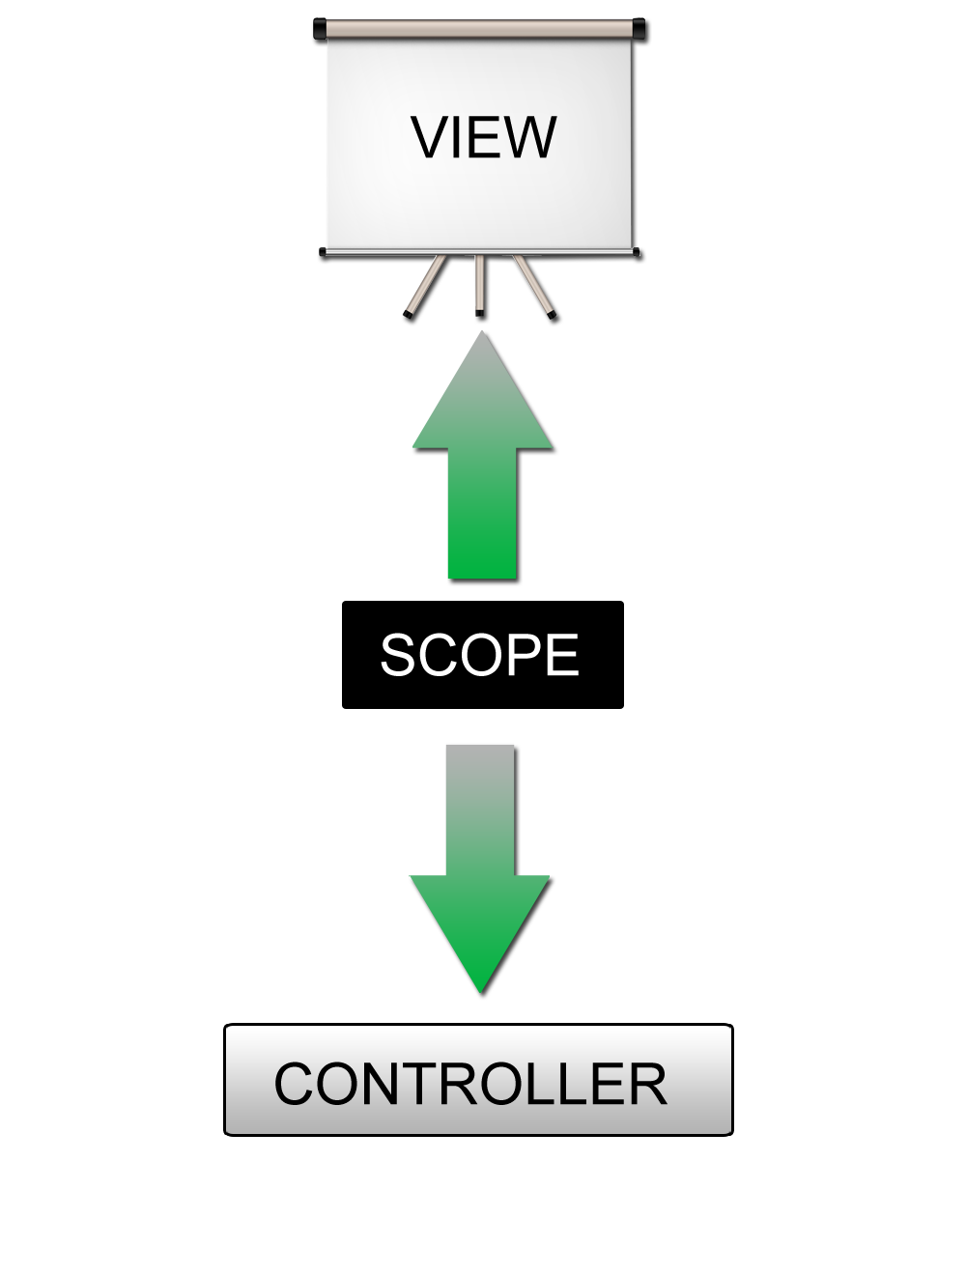
Two-way data binding illustrated

Slide 8
Example-2 & 3
Hello Module & Contoller

Slide 9
The Scope object ($scope)
One scope for each controller
The GLUE between the View and the Controller
Holds the data to display in the View
$rootScope object – visible in all controllers

Slide 10
Example- 4
Scope Inheritance

Slide 11
What is Angular directive?
Use them when you have to make DOM manipulations
Ever wanted to create your own tag or attribute – this is how you do it!

Slide 12
Directive components in ng
ng-repeat
ng-show
ng-hide
ng-if
ng-click
ng-bind
ng-model
ng-checked
ng-change
ng-focus

Slide 13
Example-5
Directives

Slide 14
What is Angular filter?
Reusable operation using which you can modify the content that is shown on the page
Examples: uppercase a value, filter search results, etc

Slide 15
List of Filters
currency | Format a number to a currency format.
filter | Select a subset of items from an array.
lowercase | Format a string to lower case.
orderBy | Orders an array by an expression.
uppercase | Format a string to upper case.

Slide 16
Example-6
Filters

Slide 17
Form Validation
required
ng-required
ng-minlength
ng-maxlength
ng-pattern
ng-trim

Slide 18
Example-7
Form Validation
Properties
myForm.email.$pristine
myForm.email.$dirty
$valid, $invalid

Slide 19
Some great resources
http://www.egghead.io/ - Angular JS video course by John Lindquist (@johnlindquist)
http://www.yearofmoo.com/ - a blog that contains some great articles about Angular JS
http://angularjs.org/ - Angular JS official web-site
http://docs.angularjs.org/api/ - Angular JS API reference
https://groups.google.com/group/angular/ - Angular JS Google Group
https://chrome.google.com/webstore/detail/angularjs-batarang/ighdmehidhipcmcojjgiloacoafjmpfk?hl=en - Angular JS Batarang, a great solution for debugging Angular JS applications
https://www.youtube.com/watch?feature=player_embedded&v=q-7mhcHXSfM#! - A video demo of using Batarang

Slide 20
Some great resources
https://github.com/angular/angular-seed
A starting point for Angular JS projects
Includes end to end tests folder where you could easily add some tests to your app using Jasmine
http://docs.angularjs.org/guide/dev_guide.e2e-testing
A guide to testing Angular JS applications
https://developer.mozilla.org/en-US/docs/Web/JavaScript/Introduction_to_Object-Oriented_JavaScript
Java Script OOPs Concept

Slide 21
Thank you

